Slide 1


STAT 515- Final Project Fall 2021
Sagar Deepakgiri Goswami
Sai Jaswanth Ku Kunku
Mehrdad Ghyabi

Slide 2

Dataset Statistics
Part1
Part2
Part3
1
2
3

Slide 3


Slide 7
Regression Research question 2:Which variables explains the life expectancy best
Part1
Part2
Part3
Multiple Linear Regression
Subset selection using Backward Method
Checking for Multicollinearity
Model Fitting & Results

Slide 8
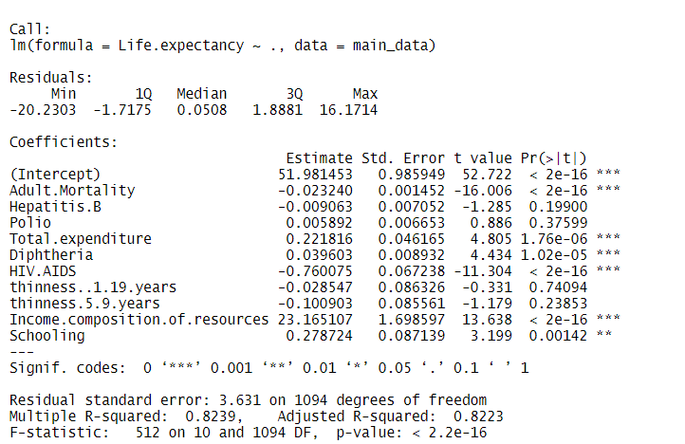
Multiple Linear Regression
1.Adult Mortality, HIV, Income composition of resources and Schooling have good statistical significance
2.Polio and Hepatitis doesn’t show any significance

Slide 9
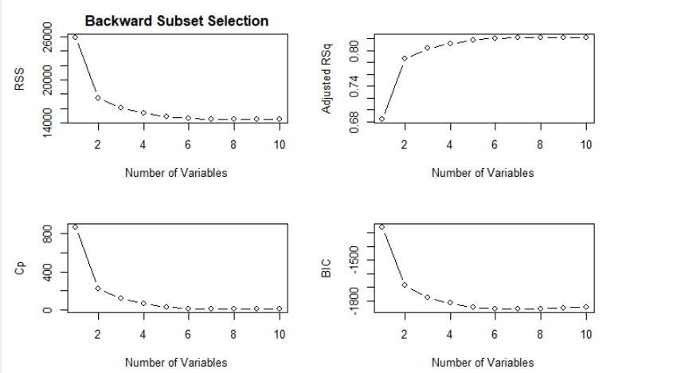
Subset selection using Backward Method
1.Model with 7 predictors explains the best fit model
2. Variables determined by based on above factors
Adult.Mortality
HIV
Thinness 5-9 years
Schooling
Income composition of resources
Total expenditure
Diphtheria

Slide 10
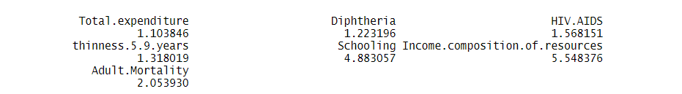
Checking for Multicollinearity
1.Determine the variation among predictors
2.Rule of Thumb -VIF>10
3.No existence of multi collinearity.

Slide 11
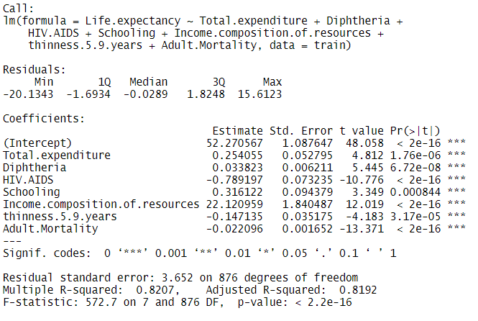
Model Fitting and Results
Fitted on 80% train data and predicted on 20% test data.
R2 of model1-0.83
RMSE of model 1-3.58
R2 of model2-0.83
RMSE of model 2-3.57

Slide 12
Research Question 3: Can we use PCA to group countries based on life expectancy by looking only on the other variables?
Part1
Part2
Part3
PCA
Country Status
Life Expectancy
Result

Slide 13
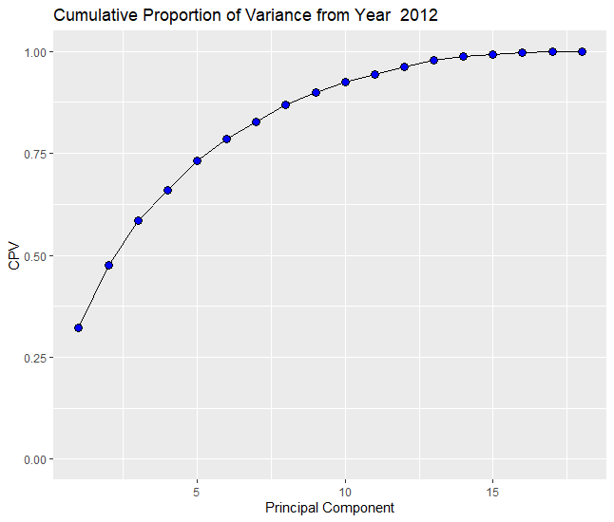
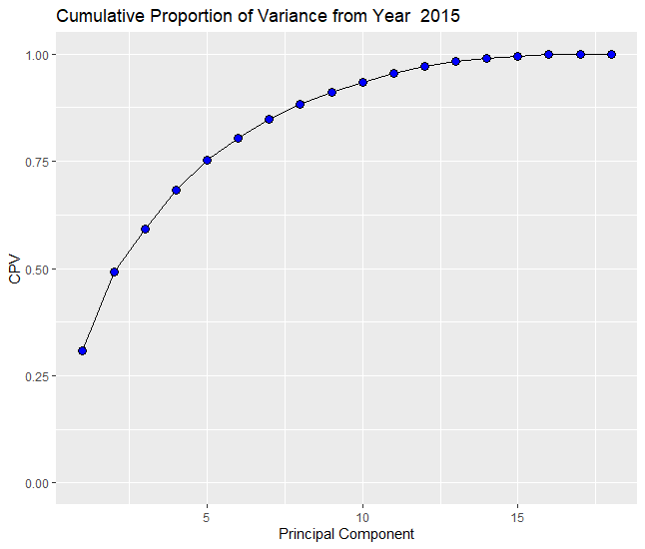
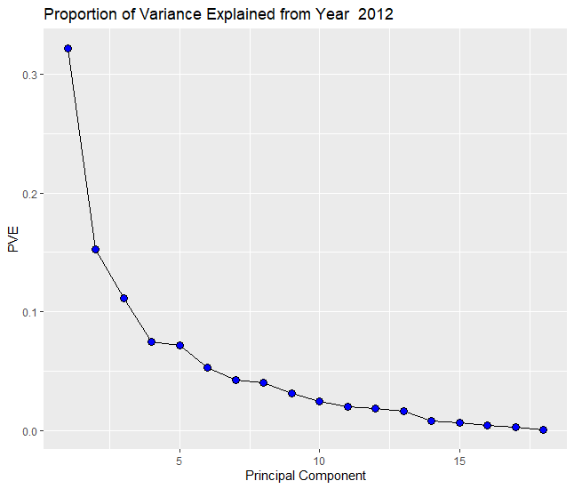
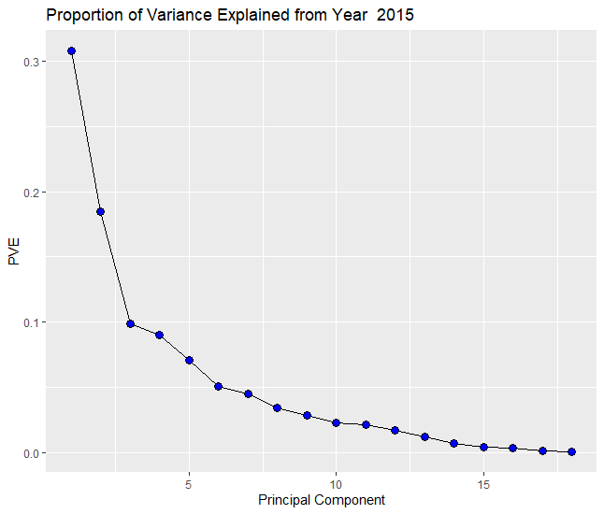

Slide 14
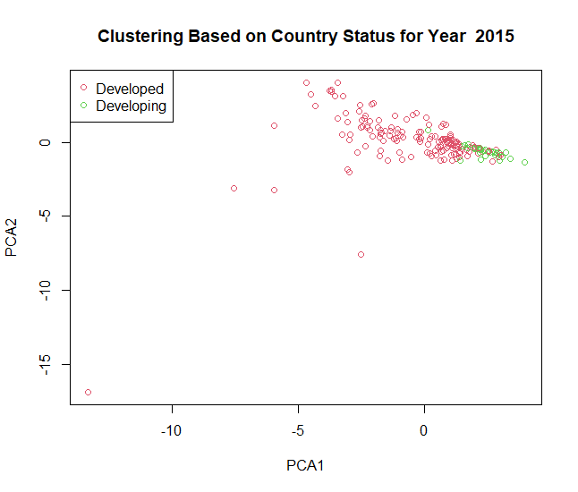
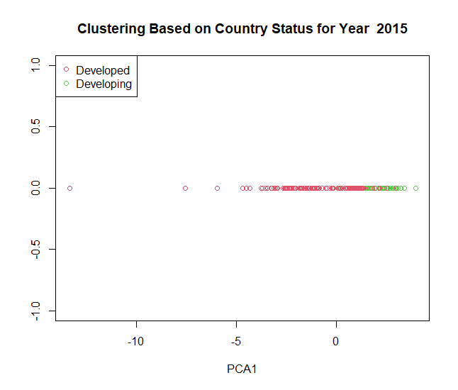
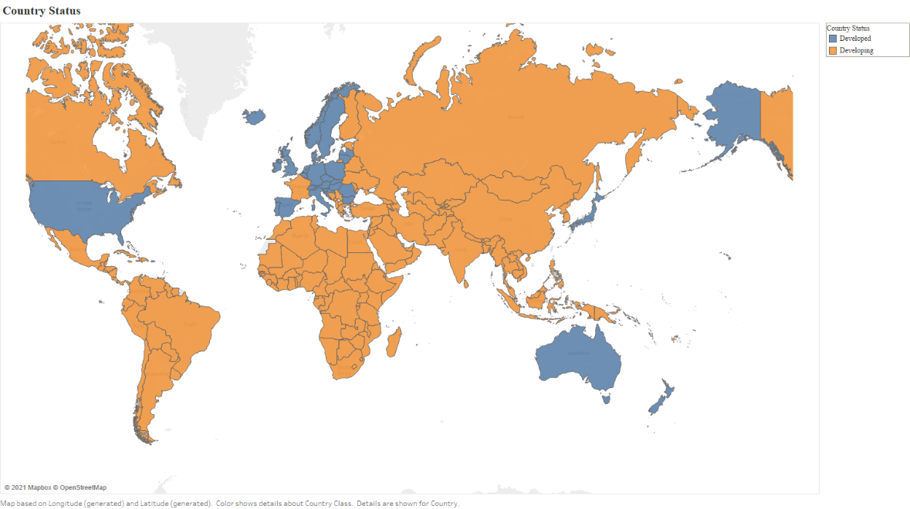

Slide 15
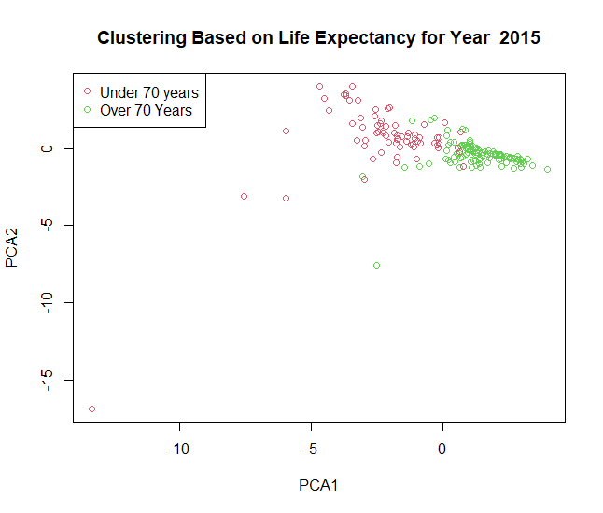
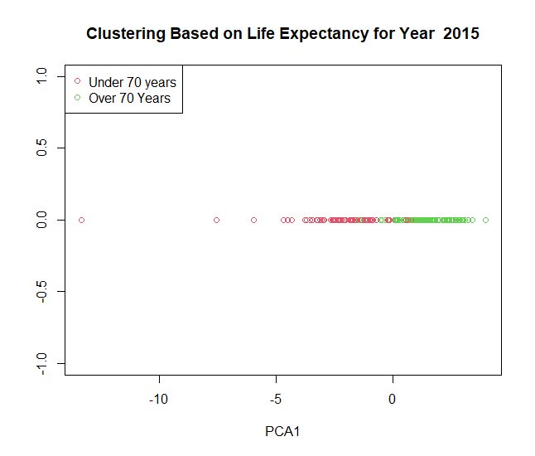
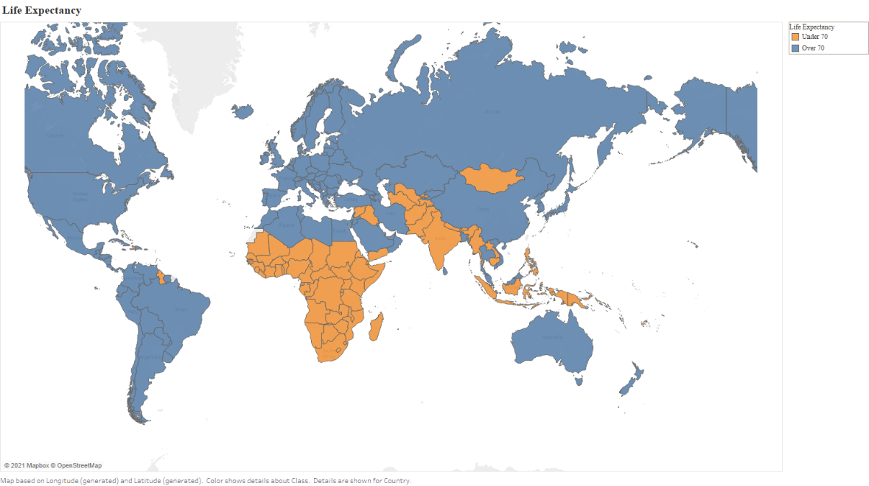

Slide 16
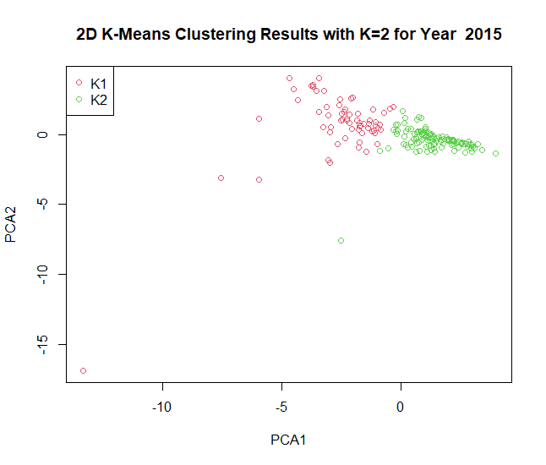
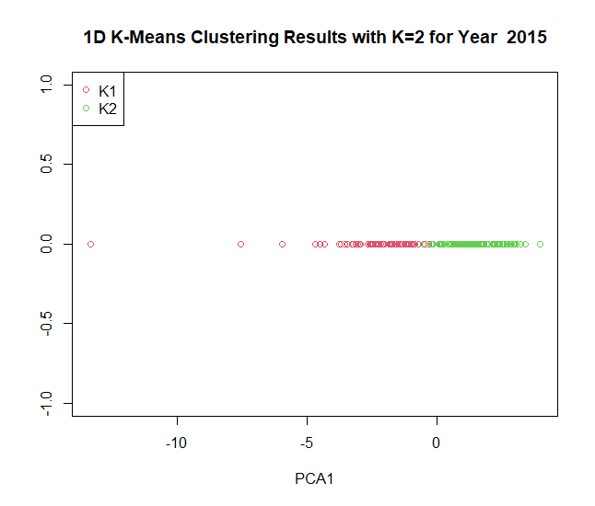
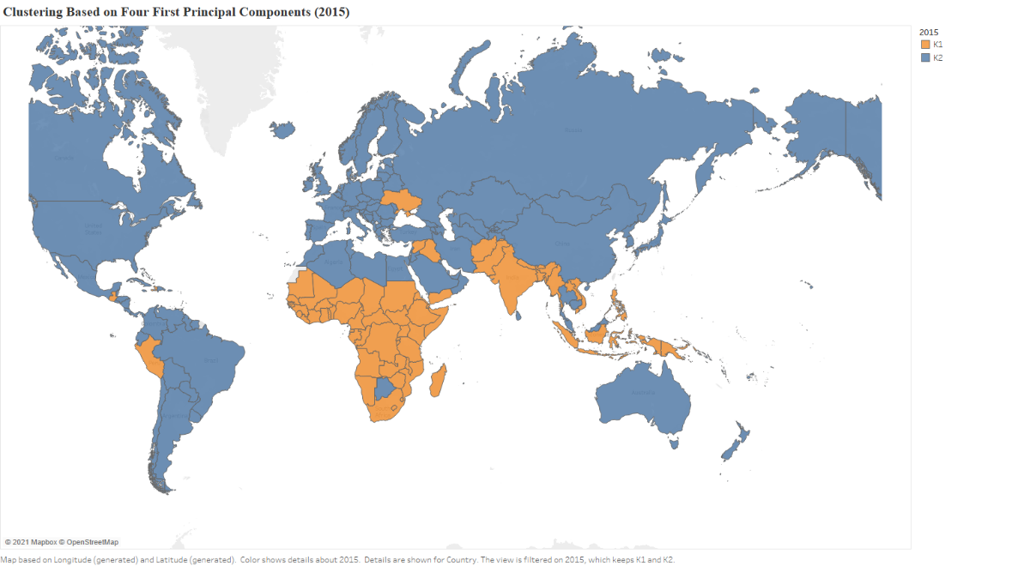

Slide 18
Thank you for your attention!

